Slide 1
Security

Slide 2
Security in the real world
Security decisions based on:
  Value, Locks, Police
Some observations:
  Not all locks are the same
  People pay for security they need
  Police are critical to the picture
  Security is only as good as the weakest link

Slide 3
Security in Computer Systems
In computer systems, this translates to:
  Authorization
  Authentication
  Audit
This is the Gold Standard for Security (Lampson)
Some security goals:
  Data confidentiality: secret data remains secret
  Data integrity: no tampering of data
  System availability: unable to make system unusable
  Privacy: protecting from misuse of user’s information

Slide 4
Security Threats
Identified by Defense Science Board:
Incomplete, inquisitive and unintentional blunders.
Hackers driven by technical challenges.
Disgruntled employees or customers seeking revenge.
Criminals interested in personal financial gain or stealing services.
Organized crime with the intent of hiding something or financial gain.
Organized terrorist groups attempting to influence U.S. policy by isolated attacks.
Foreign espionage agents seeking to exploit information for economic, political, or military purposes.
Tactical countermeasures intended to disrupt specific weapons or command structures.
Multifaceted tactical information warfare applied in a broad orchestrated manner to disrupt a major U.S. military mission.
Large organized groups or nation-states intent on overthrowing the US

Slide 5
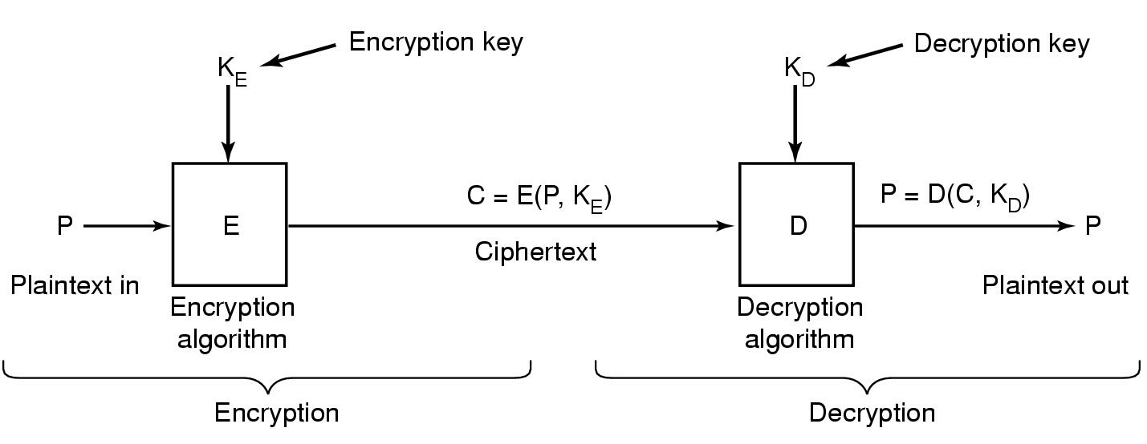
Cryptography Overview
Encrypt data so it only makes sense to authorized users
  Input data is a message or file called plaintext
  Encrypted data is called ciphertext
Encryption and decryption functions should be public
  Security by obscurity is not a good idea!

Slide 6
Secret-Key Cryptography
Also called symmetric cryptography
  Encryption algorithm is publicly known
  E(message, key) = ciphertext D(ciphertext, key) = message
Naïve scheme: monoalphabetic substitution
  Plaintext : ABCDEFGHIJKLMNOPQRSTUVWXYZ
  Ciphertext: QWERTYUIOPASDFGHJKLZXCVBNM
  So, attack is encrypted to: qzzqea
  26! possible keys ~ 4x10²⁶ possibilities
    1 µs per permutation ⇒ 10 trillion years to break
  easy to break this scheme! How?
    ‘e’ occurs 14%, ‘t’ 9.85%, ‘q’ 0.26%

Slide 7
Symmetric Key Cryptography
Which encryption algorithm is good?
  DES was proposed in the 1970s
    Encrypts 64 bits of data with 56 bit key to give 64-bit ciphertext
    Uses 16 rounds of substitution and permutation
    EFF invested $250000 to break DES message in 56 hours
    DES made powerful by encrypting message 3 times (DES3)
  Current standard is AES
    A result of 3-year competition with entries from 12 countries
    Winning entry was from Belgium, called ‘Rijndael’
  Strong algorithms, such as DES3, RC4 are used
    WEP uses RC4

Slide 8
Public Key Cryptography
Diffie and Hellman, 1976
All users get a public key and a private key
  Public key is published
  Private key is not known to anyone else
If Alice has a packet to send to Bob,
  She encrypts the packet with Bob’s public key
  Bob uses his private key to decrypt Alice’s packet
Private key linked mathematically to public key
  Difficult to derive by making it computationally infeasible (RSA)
Pros: more security, convenient, digital signatures
Cons: slower

Slide 9
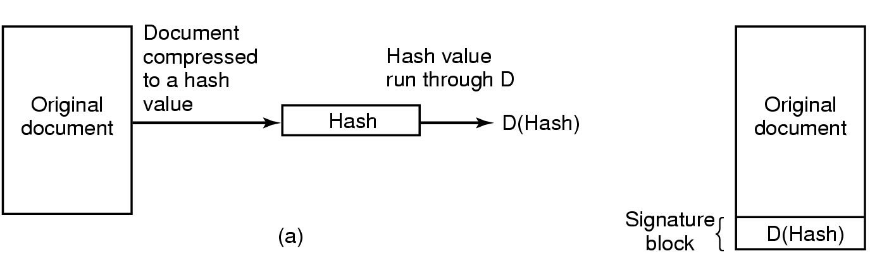
Digital Signatures
Hashing function hard to invert, e.g. MD5, SHA
Apply private key to hash (decrypt hash)
  Called signature block
Receiver uses sender’s public key on signature block
  E(D(x)) = x should work (works for RSA)

Slide 10
Authentication
Establish the identity of user/machine by
  Something you know (password, secret)
  Something you have (credit card, smart card)
  Something you are (retinal scan, fingerprint)
In the case of an OS this is done during login
  OS wants to know who the user is
Passwords: secret known only to the subject
  Simplest OS implementation keeps (login, password) pair
  Authenticates user on login by checking the password
  Try to make this scheme as secure as possible!
    Display the password when being typed? (Windows, UNIX)

Slide 11
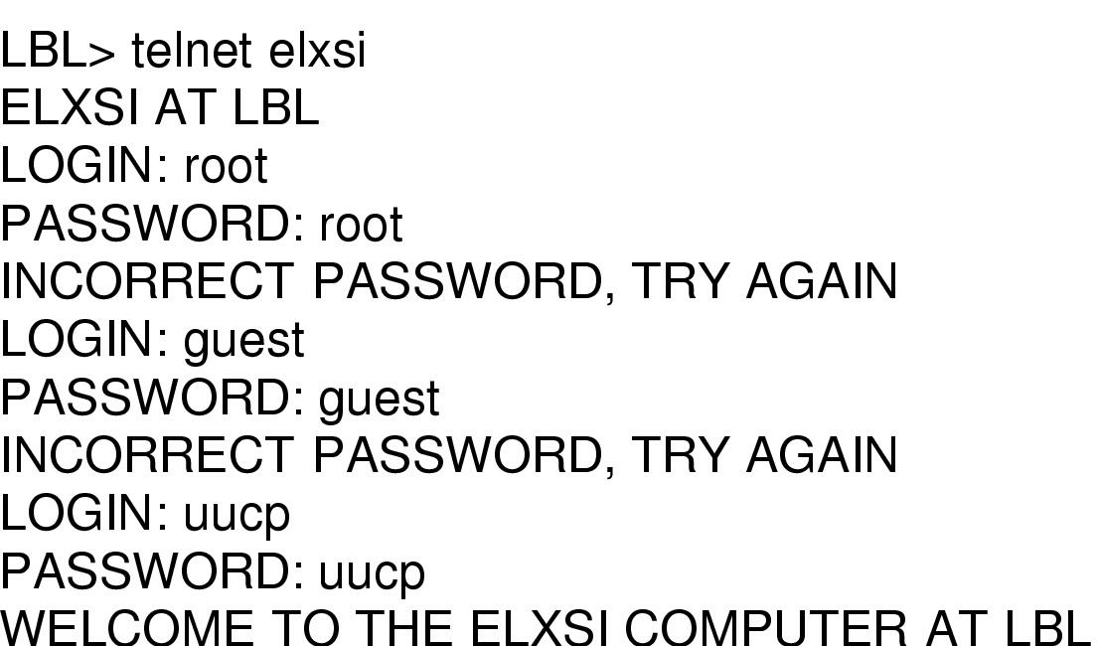
Online passwords attacks
Online attacks: system used to verify the guesses
  How someone broke into LBL
  Thwart these attacks:
    limit the number of guesses
    better passwords

Slide 12
Offline password attacks
Depends on how passwords are stored
Approach 1: store username/password in a file
  Attacker only needs to read the password file
  Security of system now depends on protection of this file!
Approach 2: store username/encrypted password in file
  Properties of the one-way hash function h:
    h is not invertible: h(m) easy to compute, h⁻¹(m) difficult
    It is hard to find m and m’ s.t. h(m) = h(m’)
  Should use standard functions, such as SHA, MD5, etc.
Compare
Password
FILE
Crypto hash

Slide 13
More offline attacks
Previous scheme can be attacked: Dictionary Attack
  Attacker builds dictionary of likely passwords offline
  At leisure, builds hash of all the entries
  Checks file to see if hash matches any entry in password file
  There will be a match unless passwords are truly random
  20-30% of passwords in UNIX are variants of common words
    Morris, Thompson 1979, Klein 1990, Kabay 1997
Solutions:
  Shadow files: move password file to /etc/shadow
    This is accessible only to users with root permissions
  Salt: store (user name, salt, E(password+salt))
    Simple dictionary attack will not work. Search space is more.

Slide 14
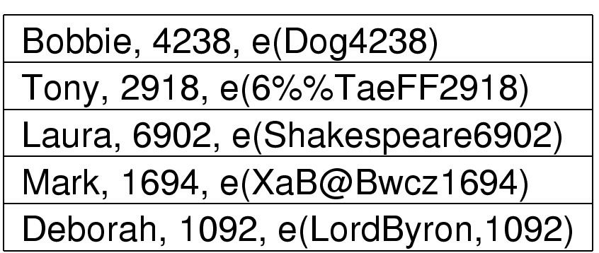
Salting Example
If the hacker guesses Dog, he has to try Dog0001, …
UNIX adds 12-bit of salt
Passwords should be made secure:
  Length, case, digits, not from dictionary
  Can be imposed by the OS! This has its own tradeoffs

Slide 15
One time passwords
Password lasts only once
  User gets book with passwords
  Each login uses next password in list
  UNBREAKABLE..

Slide 16
Challenge Response Scheme
New user provides server with list of ques/ans pairs
  Server asks one of them at random
  Requires a long list of question answer pairs
Prove identity by computing a secret function
  User picks an algorithm, e.g. x²
  Server picks a challenge, e.g. x=7
  User sends back 49
  Should be difficult to deduce function by looking at results
In practice
  The algorithm is fixed, e.g. one-way hash, but user selects a key
  The server’s challenge is combined with user’s key to provide input to the function

Slide 17
Auth. Using Physical Objects
Door keys have been around long
Plastic card inserted into reader associated with comp
  Also a password known to user, to protect against lost card
Magnetic stripe cards: about 140 bytes info glued to card
  Is read by terminal and sent to computer
  Info contains encrypted user password (only bank knows key)
Chip cards: have an integrated circuit
  Stored value cards: have EEPROM memory but no CPU
    Value on card can only be changed by CPU on another comp
  Smart cards: 4 MHz 8-bit CPU, 16 KB ROM, 4 KB EEPROM, 512 bytes RAM, 9600 bps comm. channel

Slide 18
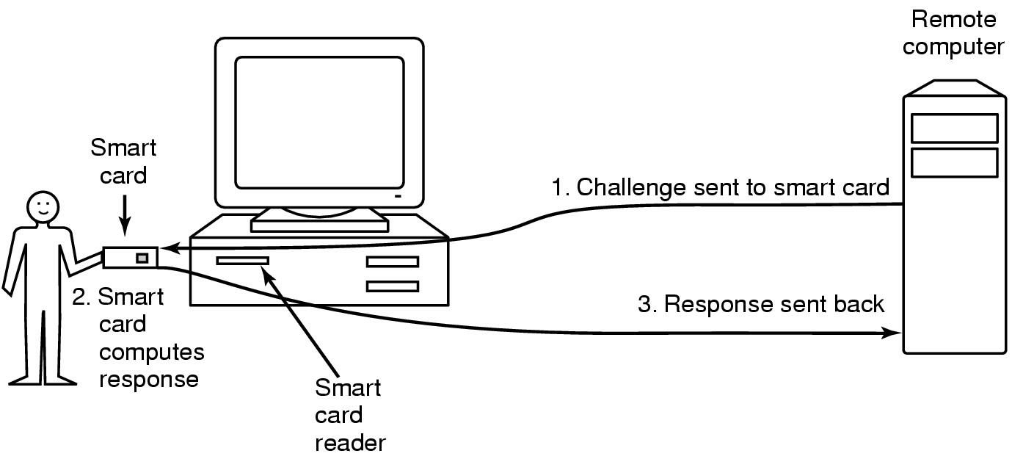
Smart Cards
Better security than stored value cards
  Card sends a small encrypted msg. to merchant, who can later use it to get money from the bank
  Pros: no online connection to bank required
Perform local computations, remember long passwords

Slide 19
Biometrics: something you are
System has 2 components:
  Enrollment: measure characteristics and store on comp
  Identification: match with user supplied values
What are good characteristics?
  Finger length, voice, hair color, retinal pattern, voice, blood
Pros: user carries around a good password
Cons: difficult to change password, can be subverted

Slide 20
Security: Attacks

Slide 21
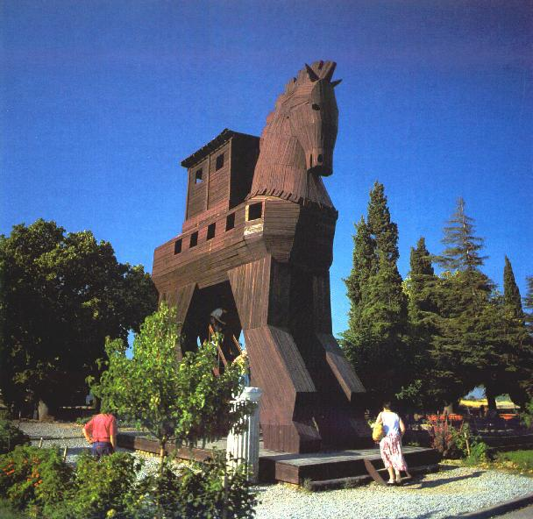
Trojan Horse
Malicious program disguised as an innocent one
  Could modify/delete user’s file, send important info to cracker, etc
The program has to get to the computer somehow
  Cracker hides it as a new game, e-card, windows update site, etc.
When run, Trojan Horse executes with user’s privileges
Examples:
  Hide program in path directory as a common typo: la for ls
  Malicious user puts malicious ls in directory, and attracts superuser
    Malicious ls could make user the superuser
    Denning’s paper 1999

Slide 22
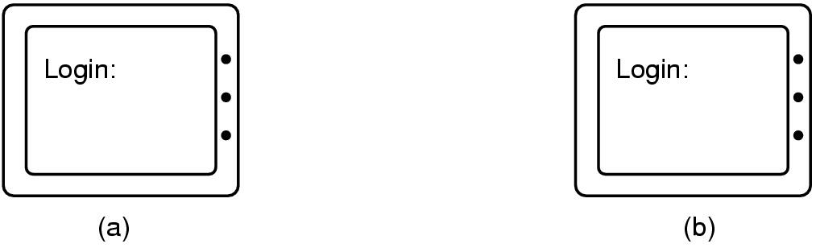
Login Spoofing
Specialized case of Trojan Horse
  Attacker displays a custom screen that user thinks belong to the system
  User responds by typing in user name and password
  Can be circumvented by key sequence that user programs cannot catch: e.g. CTRL+ALT+DEL in Windows

Slide 23
Logic Bombs
Piece of code, in the OS or app, which is dormant until a certain time has elapsed or event has occurred
  Event could be missing employee record from payroll
Could act as a Trojan Horse/virus once triggered
Also called “slag code” or “time bomb”
Recovery options for a firm include:
  Calling the police
  Rehiring the programmer

Slide 24
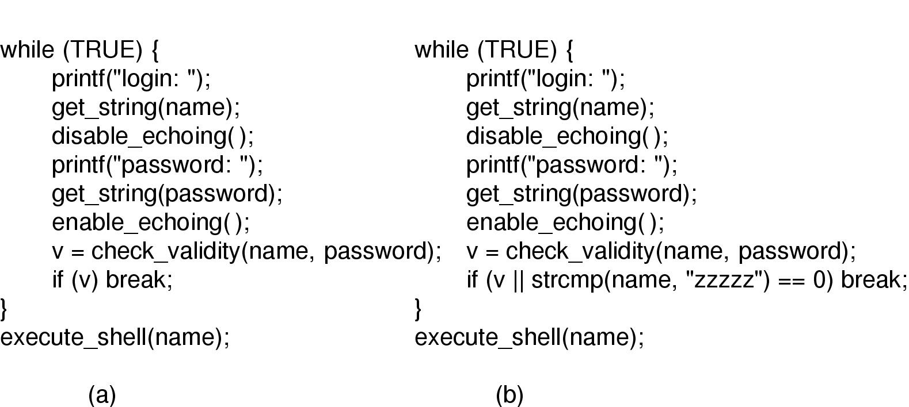
Trap Doors
Code in system inserted by programmer to bypass normal check
Ken Thompson “Reflections on Trusting Trust”
  Hole in UNIX system utility; enforced by C compiler

Slide 25
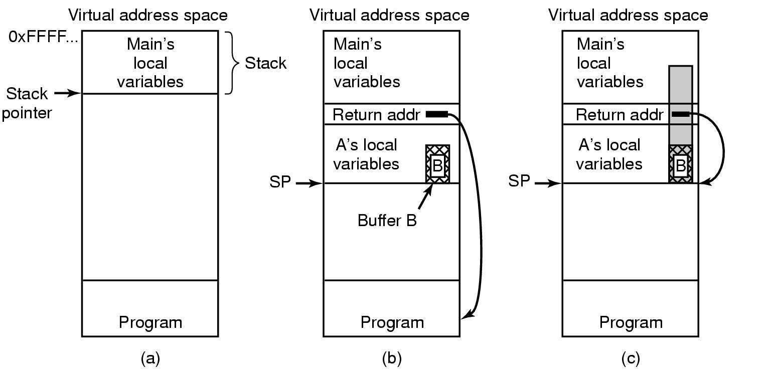
Buffer Overflow
C compiler does no array bounds checking
  A number of programs a written in C
  Cracker can force his routine to run by violating array bounds

Slide 26
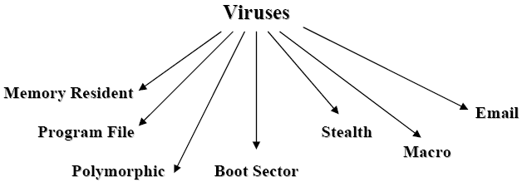
Viruses and Worms
Virus is a program that reproduces itself by attaching its code to another program
  They require human intervention to spread
  Melissa, I LOVE YOU spread by e-mail
Worms actively replicate without a helper program
  Is a subclass of virus, but does not require user intervention
  Sasser and Blaster targeted machines with out of date software

Slide 27
Denial of Service
Client sends a legitimate-looking request for service to a service provider
Service provider commits the necessary resources to provide the service
  Ports, buffer space, bandwidth
The resources are wasted, legitimate users get diminished service
  Usually launched from many computers controlled by attackers
Possible whenever the cost to ask for service is far cheaper than the cost of providing it
  Challenge-response mechanism, selective packet tagging

Slide 28
Other Network Attacks
Protocol attacks:
  E.g. IEEE 802.11 WEP
Brute force attacks
Use Network Firewalls to reduce security risk

Slide 29
Protection: ACLs & Capabilities

Slide 30
Encoding Security
Depends on how a system represents the Matrix
  Not much sense in storing entire matrix!
  ACL: column for each object stored as a list for the object
  Capabilities: row for each subject stored as list for the subject
 | Cs414 grades | Cs415 grades | Emacs
Ranveer | r/w | r/w | Kill/resume
Tom | r | r/w | None
Mohamed | r | r | None

Slide 31
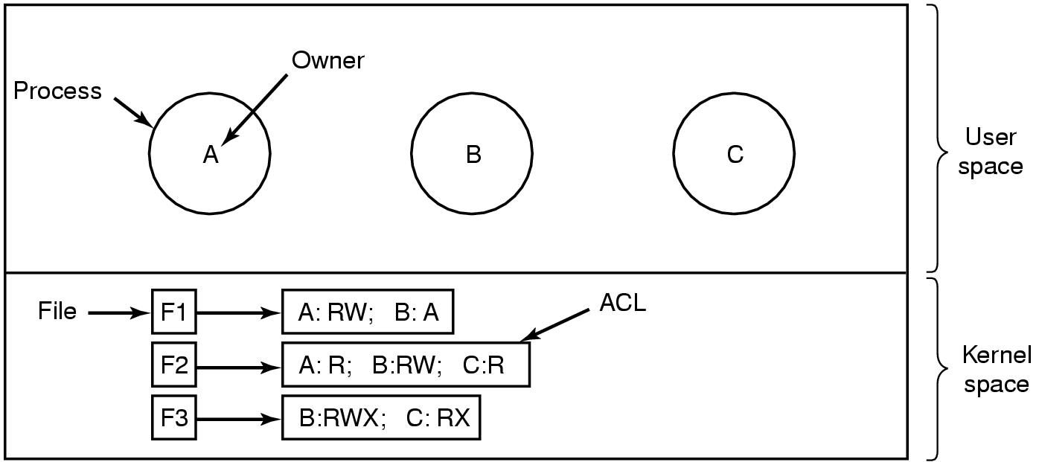
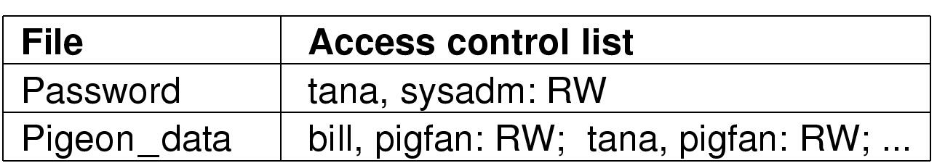
Access Control Lists
Example: to control file access
  Each file has an ACL associated with it

Slide 32
Access Control Lists Examples
UNIX: has uid and gid
  Each i-node has 12 mode bits for user, group and others
  What does x without r mean for a directory?
    Can access file if you know the name, but cannot list names
  What does r without x mean?
    Can list files, but cannot access them
  Only the owner can change these rights with chmod command
  Last 3 mode bits allow process to change across domains
In NTFS: each file has a set of properties (ACL is one)
  Richer set than UNIX: RWX P(permission) O(owner) D(delete)
  Further packaging: read (RX), change (RWXO), full control (RWXOPD)

Slide 33
ACLs Discussion
Need good data structures
User will need to have multiple identities
Need defaults for new objects
Good security metaphors to users are needed!

Slide 34
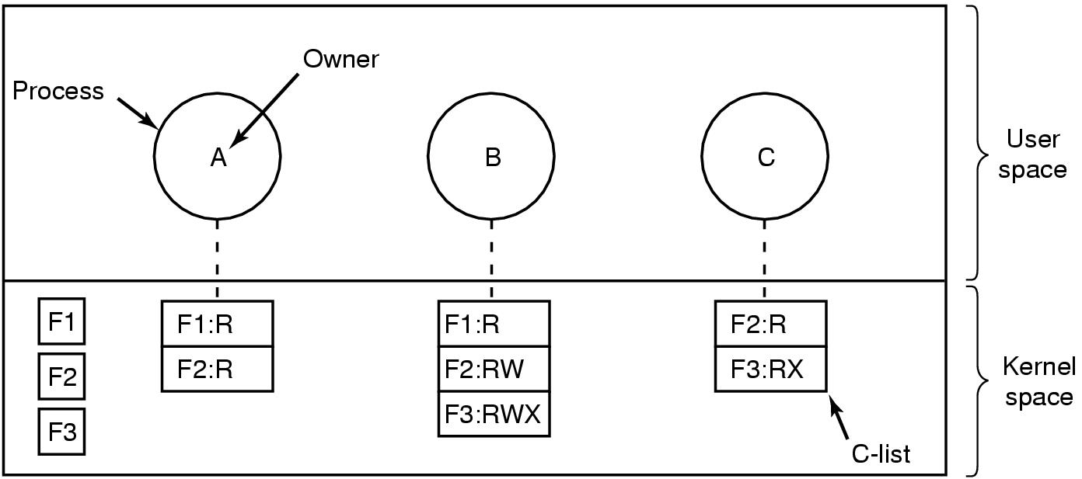
Capabilities
Store information by rows
  For each subject, there is list of objects that it can access
  Called a capability list of c-list; individual items are capabilities
    C-lists are objects too, and may be pointed to from other c-lists

Slide 35
Capabilities
To access an object, subject presents the capability
  ‘capability’ word coined by Dennis and Van Horn in 1966
  Capability is (x, r) list. x is object and r is set of rights
  Capabilities are transferable
How to name an object?
  Is start address sufficient?
    Array and first element of array have same address
  Is start address + length of object sufficient?
    What if start address changes?
  Random bit string: use hash table to translate from name to bits
Need to protect capabilities from being forged by others
  ACLs were inherently unforgeable

Slide 36
Protecting Capabilities
Prevent users from tampering with capabilities
Tagged Architecture
  Each memory word has extra bit indicating that it is a capability
  These bits can only be modified in kernel mode
  Cannot be used for arithmetic, etc.
Sparse name space implementation
  Kernel stores capability as object+rights+random number
  Give copy of capability to the user; user can transfer rights
  Relies on inability of user to guess the random number
    Need a good random number generator

Slide 37
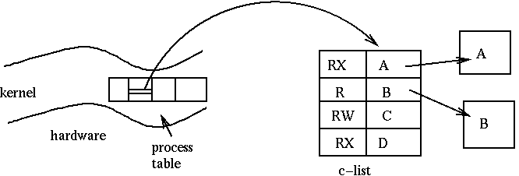
Protecting Capabilities
Kernel capabilities: per-process capability information
  Store the C-list in kernel memory
  Process access capabilities by offset into the C-list
  Indirection used to make capabilities unforgeable
  Meta instructions to add/delete/modify capabilities

Slide 38
Protecting Capabilities
Cryptographically protected capabilities
  Store capabilities in user space; useful for distributed systems
  Store <server, object, rights, f(object, rights, check)> tuple
  The check is a nonce,
    unique number generated when capability is created;
    kept with object on the server; never sent on the network
Language-protected capabilities
  SPIN operating system (Mesa, Java, etc.)

Slide 39
Capability Revocation
Kernel based implementation
  Kernel keeps track of all capabilities; invalidates on revocation
Object keeps track of revocation list
  Difficult to implement
Timeout the capabilities
  How long should the expiration timer be?
Revocation by indirection
  Grant access to object by creating alias; give capability to alias
  Difficult to review all capabilities
Revocation with conditional capabilities
  Object has state called “big bag”
  Access only if capability’s little bag has sth. in object’s big bag

Slide 40
Comparing ACLs & Capabilities
Number of comparisons on opening a file?
  Capability: just one ACLs: linear with number of subjects
Implementing when no groups are supported:
  Capabilities: easier ACLs: Need to enumerate all the subjects
Finding out who has access to an object?
  Capabilities: difficult
Is it possible to control propagation of rights?
  Capabilities: some counter can be used
Selective revocation of rights:
  Easy for ACLs (no immediate effect); difficult for capabilities
Easier propagation of rights for capabilities

Slide 41
Trusted Systems
The computer world right now is full of security problems
Can we build a secure computer system?
  Yes!
Then why has it not been built yet?
  Users unwilling to throw out existing systems
  New systems have more features, so:
    more complexity, code, bugs and security errors
Examples: e-mail (from ASCII to Word), web (applets)
Trusted Systems: formally stated security requirements, and how they are met

Slide 42
Trusted Computing Base
Heart of every trusted system has a small TCB
  Hardware and software necessary for enforcing all security rules
  Typically has:
    most hardware,
    Portion of OS kernel, and
    most or all programs with superuser power
Desirable features include:
  Should be small
  Should be separable and well defined
  Easy to audit independently

Slide 43
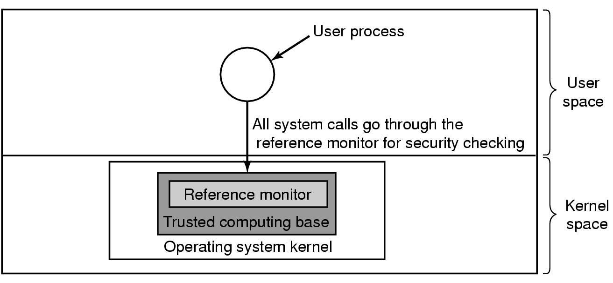
Reference Monitor
Critical component of the TCB
  All sensitive operations go through the reference monitor
  Monitor decides if the operation should proceed
  Not there in most OSes

Slide 44
Access Control
Discretionary Access Control (DAC)
  Subjects can determine who has access to their objects
  Commonly used, for example in Unix File System
  Is flawed for tighter security, since program might be buggy
Mandatory Access Control (MAC)
  System imposes access control policy that object owner’s cannot change
  Multi-level Security as an example of MAC
    MLS is environment where there are various security levels
      Eg. Classify info as unclassified, confidential, secret, top secret
      General sees all documents, lieutenant can only see below confidential
    Restrict information flow in environments where various levels interact

Slide 45
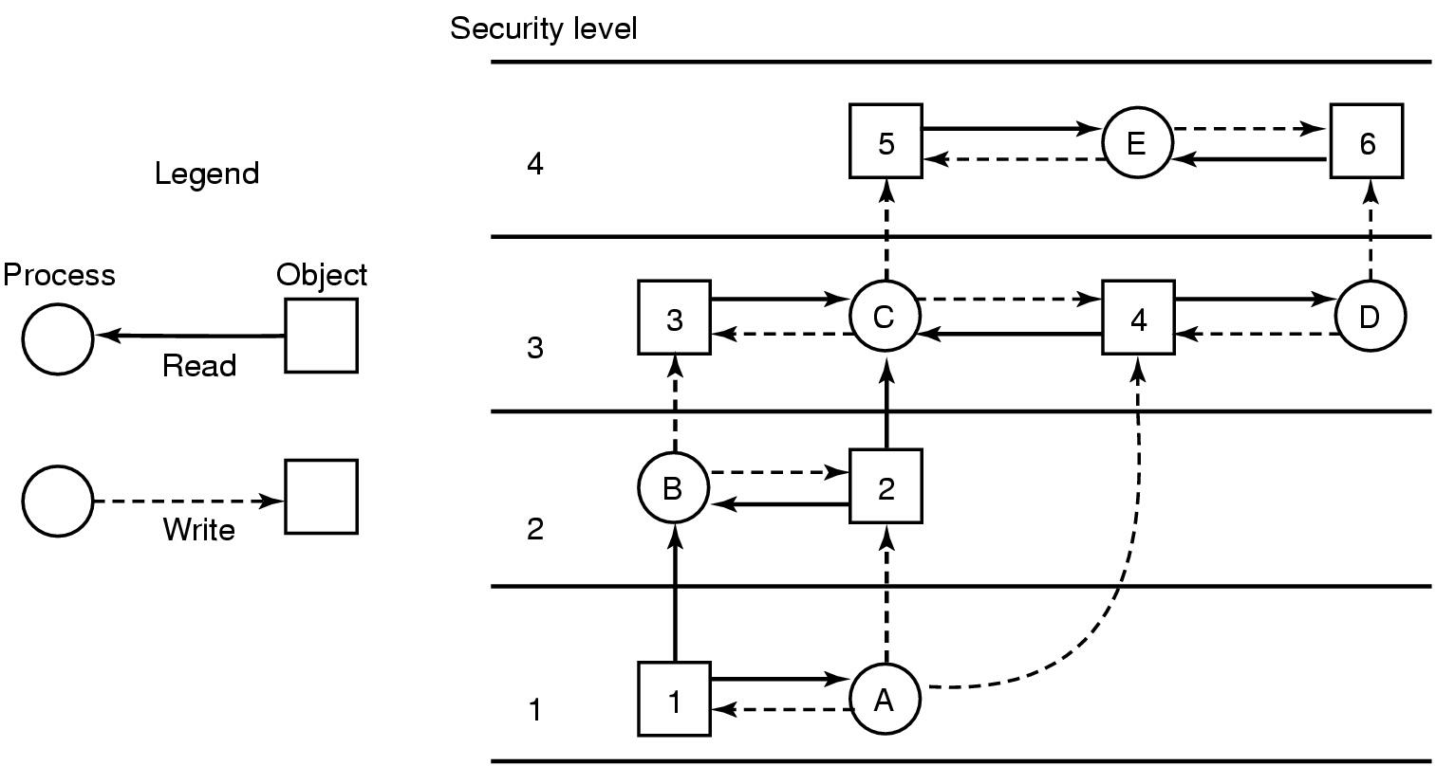
Bell-La Padula Model
“no read up, no write down”
Properties to satisfy for information flow
  Security property: user at level ‘k’ can read objects at level ‘j’
    j <= k
  * property: user can write objects at level j >= k

Slide 46
Biba Model
“No write up, no read down”
Integrity property: A user at security level k can write only objects at level j, j <= k
The integrity * property: A user at level k can read only objects at level j, j >= k
Want Bell-La Padula and Biba in the same system, for different types of objects
  But Bell-La Padula and Biba are in direct conflict (Confidentiality vs. Data Integrity)
In practice, a mix of DAC and MAC

Slide 47
Covert Channels
Do these ideas make our system completely secure?
  No. Security leaks possible even in a system proved secure mathematically. Lampson 1973
Model: 3 processes. The client, server and collaborator
  Server and collaborator collude
  Goal: design a system where it is impossible for server to leak to the collaborator info received from the client (Confinement)
Solution: Access Matrix prevents server to write to a file that collaborator has read access; no IPC either
BUT: Covert Channel => compute hard for 1, sleep for a 0
Others: paging, file locking with ACKs, pass secret info even though there is censor

Slide 48
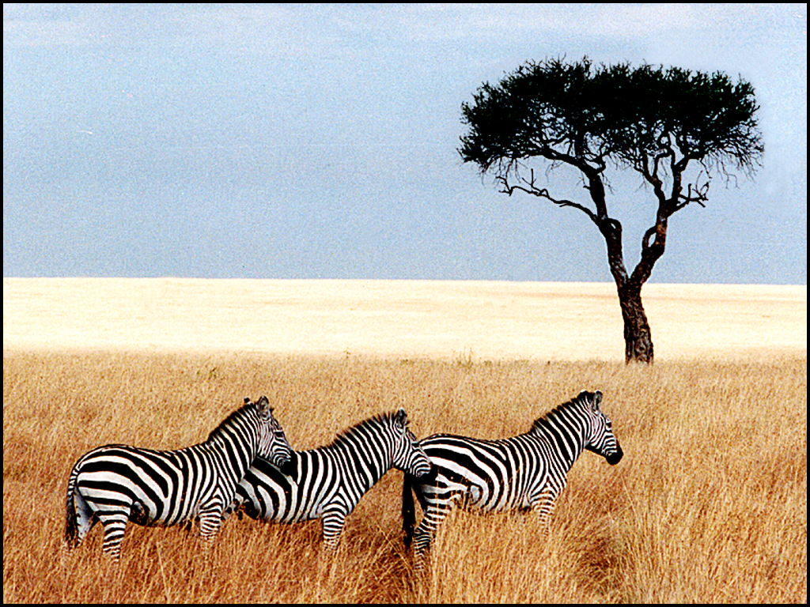
Steganography
Pictures appear the same
Picture on right has text of 5 Shakespeare plays
  encrypted, inserted into low order bits of color values
Zebras
Hamlet, Macbeth, Julius Caesar
Merchant of Venice, King Lear

Slide 49
Orange Book
Dept. of Defense Standards DoD 5200.28 in 1985
  Known as Orange Book for the color of its cover
Divides OSes into categories based on security property
  D – Minimal security.
  C – Provides discretionary protection through auditing. Divided into C1 and C2. C1 identifies cooperating users with the same level of protection. C2 allows user-level access control.
  B – All the properties of C, however each object may have unique sensitivity labels. Divided into B1, B2, and B3.
  A – Uses formal design and verification techniques to ensure security.

